Slide 1


Facial Emotion Classification for Enhancing Human-Robot Interaction
Course: Machine Learning And Data Analysis DIBRIS - University of Genova
MS in Robotics Engineering
Roumaissa Benkredda (s5434673)
Seyed Amir Mohamad Hosseini Rad (s5480861)

Slide 2

The Project Introduction
Overview
Objective: The primary goal of this project is to enhance human-robot interaction by developing a robust facial emotion recognition system.
Importance: Emotion recognition stands as a crucial component in the evolving field of human-computer interaction.
Technological Foundation:
This project leverages the power of Convolutional Neural Networks (CNNs), utilizing deep learning frameworks to process and classify facial expressions.
Tools and Libraries Used:
We employed Python as our primary programming language, with extensive use of libraries such as Keras for building the CNN models, and other data handling and visualization tools.

Slide 3

The Project Introduction
Dataset Collection: Our dataset was sourced from Kaggle. This dataset features images of facial expressions labeled with seven different emotions: anger, disgust, fear, happiness, neutral, sadness, and surprise.
The dataset includes 18663 of grayscale images categorized by emotion. Each image is standardized to a size of 48x48 pixels.
Outcome and Application: The outcomes of this project include a detailed comparative analysis of how different CNN configurations perform, providing valuable insights into optimizing neural networks for facial emotion recognition.
As a result, a trained model capable of recognizing and classifying facial emotions with higher accuracy is developed, intended for integration into robotic systems to make them more interactive and responsive to human emotions.

Slide 4
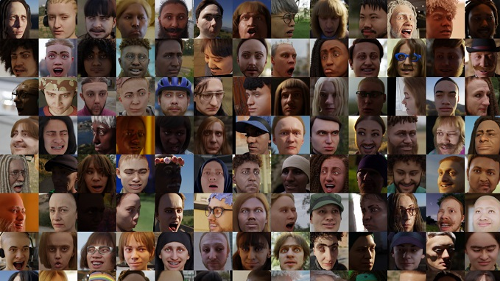
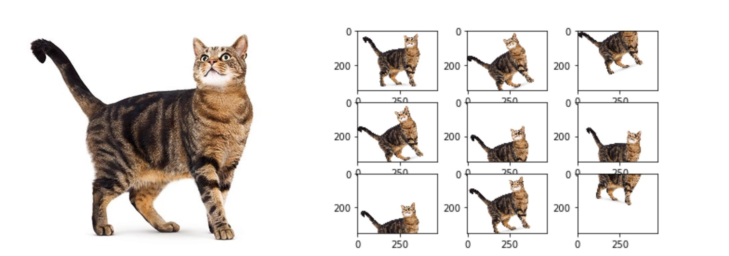
Data Preparation
Image Preprocessing:
Grayscale Conversion: Although the images are already in grayscale, this step ensures that images fed into the model are grayscale standardizes the input and reduces computational complexity.
Image Augmentation:
We used Keras's ImageDataGenerator for image augmentation, which includes modifications like rotation, scaling, and flips. This process helps in making our model robust to variations in new, unseen data by simulating different conditions.

Slide 5
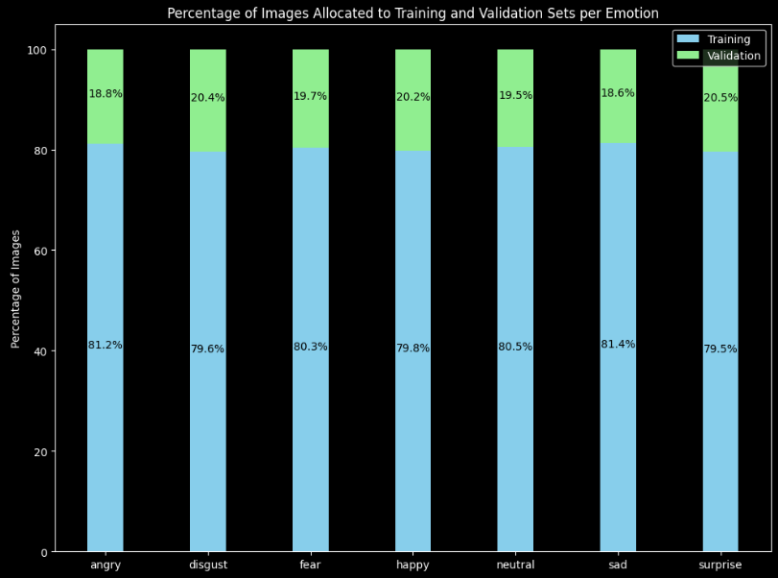
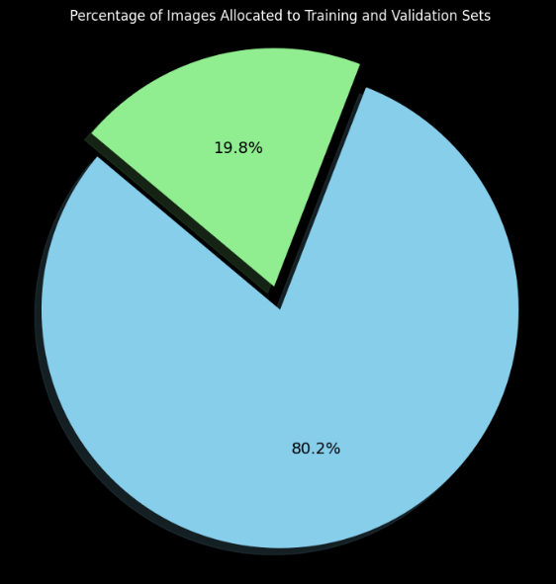
Data Preparation
Directory Structure: Our data is organized in a structured directory where each subdirectory represents an emotion class. Keras automatically labels images based on the directory they are located in.
Training/Validation Data Split:
Training Set: Contains a majority of the images and is used to train the models.
Validation Set: Comprises a smaller portion of the images, used to validate the model's performance and generalize its ability to new, unseen data.

Slide 6

Introduction to CNN
A Convolutional Neural Network (CNN) is a deep learning algorithm which can take in an input image, assign importance (learnable weights and biases) to various aspects/objects in the image, and be able to differentiate one from the other. Unlike traditional machine learning algorithms, CNNs automatically detect important features without any human supervision. Applications of CNNs:
Image and Video Recognition: Such as face recognition.
Medical Image Analysis: Like MRIs and CT scans.
Automotive Safety: Used in autonomous vehicles to detect objects like pedestrians, signs, …
Advantages of Using CNNs in our Project:
Automated Feature Detection: CNNs automatically determine the important features, saving time and improving efficiency.
Accuracy: CNNs are known for their high accuracy in image recognition tasks.

Slide 7
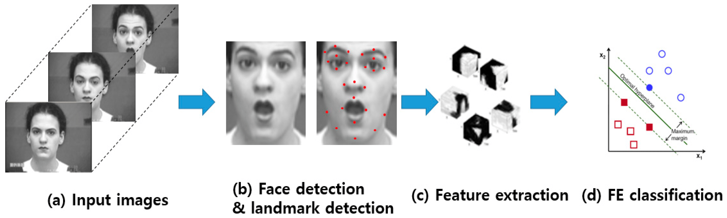
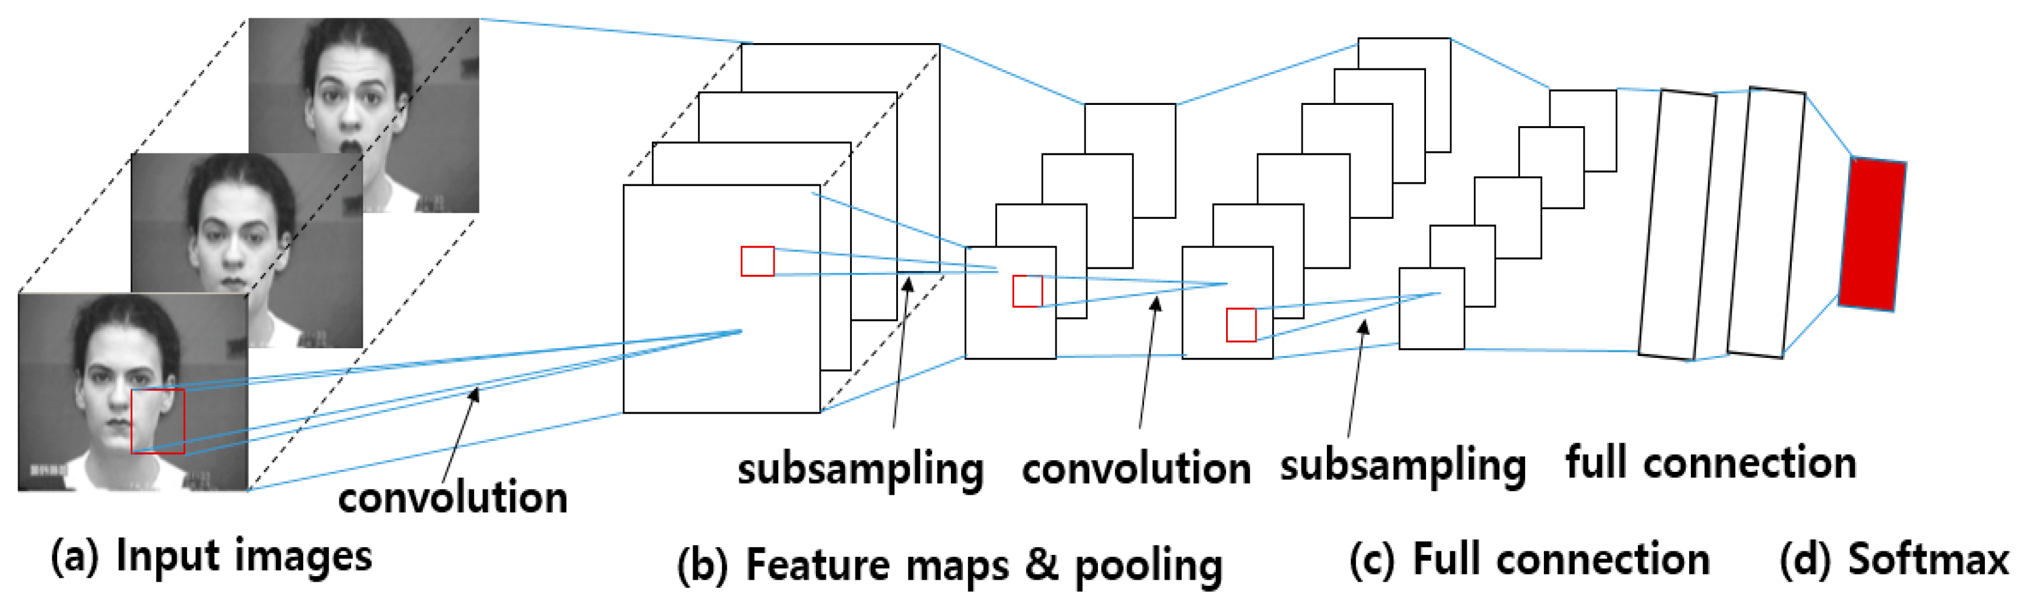
How CNN Learns
Layered Architecture:
Input Layer: This is where the CNN first receives the image as input.
Hidden Layers: (Convolutional and Dense Layers) These layers form the core of the CNN. Each hidden layer applies specific filters to the input to detect fundamental attributes like edges and textures early on. These features are then passed through additional layers, which combine the simple patterns to identify more complex shapes and details. Each layer's output is a refined, focused feature set that feeds into the next layer, enhancing the network's ability to understand and classify the image comprehensively. Output Layer: The final layer outputs the classification results based on the aggregated and processed information from previous layers.

Slide 8
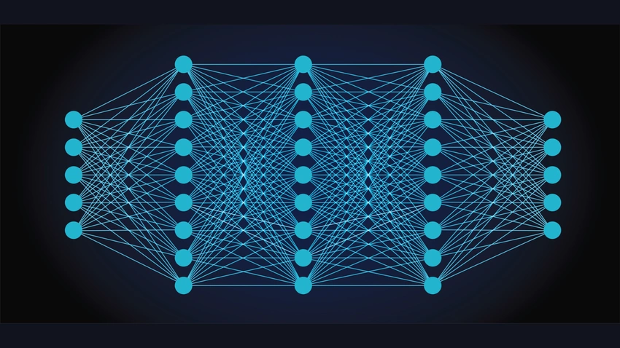
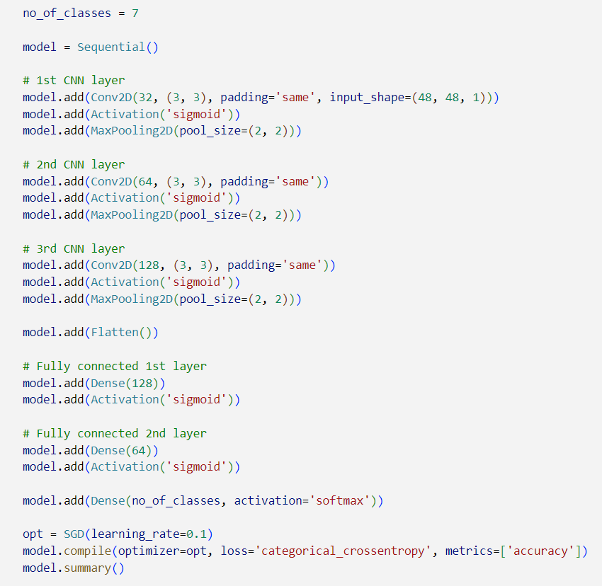
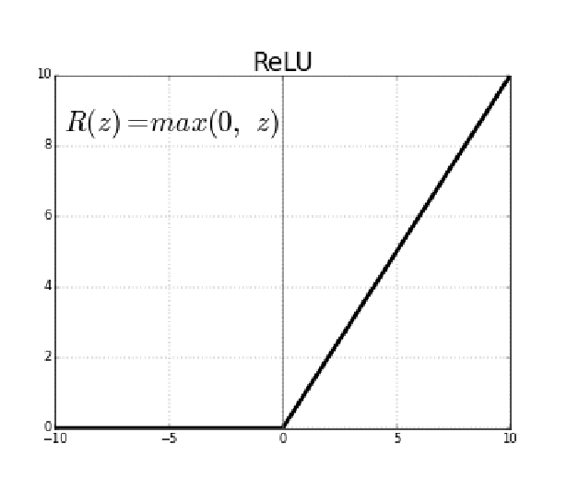
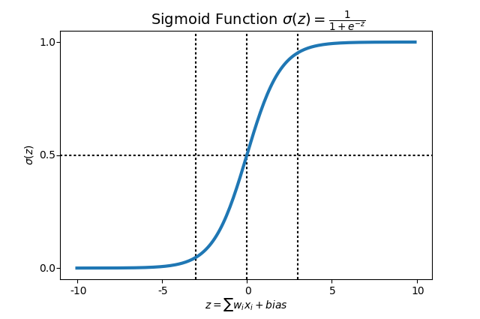
CNN Layers
Convolutional Layers:
Convolutional layers are the primary building blocks of a CNN, designed to apply a set of learnable filters to the input, thereby capturing important features such as edges, colors, and textures. For instance, in this model, the first layer utilizes 32 filters of size 3x3 to capture basic features.
Activation Function:
Activation layers in CNNs introduce non-linear properties to the network, crucial for learning complex patterns beyond the capabilities of linear operations.
Sigmoid: Useful for binary classification problems.
ReLU : Helps mitigate the vanishing gradient problem, enabling faster and more effective training.

Slide 9
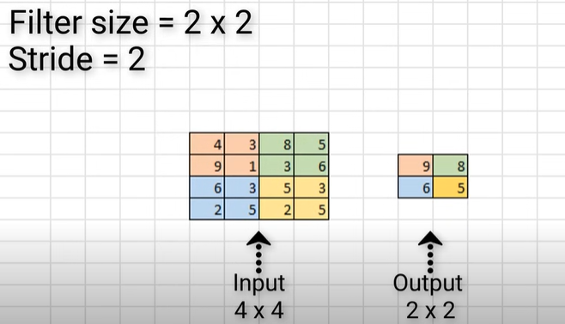
CNN Layers
Pooling Layers:
Pooling layers serve to reduce the dimensionality of each feature map while retaining the most significant information. Max pooling operates by applying a filter (e.g., 2x2) with a specific stride (e.g., 2), selecting the maximum value within each region, which emphasizes the most prominent features and provides translation invariance, typically used in the early layers of CNNs. In contrast, average pooling applies the same filter and stride but computes the average value within each region, preserving the overall distribution and smoothing features. This makes it beneficial in later layers or specific applications like Global Average Pooling before fully connected layers.
Padding:
Padding is used in CNNs to control the spatial dimensions of output feature maps. Zero padding involves adding extra pixels with a value of zero around the edges of the input feature map to preserve its size and retain edge information. Types of padding include:
Valid Padding: No padding; the output is smaller than the input.
Same Padding: Padding is added to keep the output size the same as the input.
Full Padding: Padding ensures the output is larger than the input, covering all filter positions, including those extending beyond the input boundaries.
Notes:
max pooling focuses on capturing strong, distinctive features, while average pooling captures overall trends, with the choice depending on the neural network's specific requirements and tasks.

Slide 10
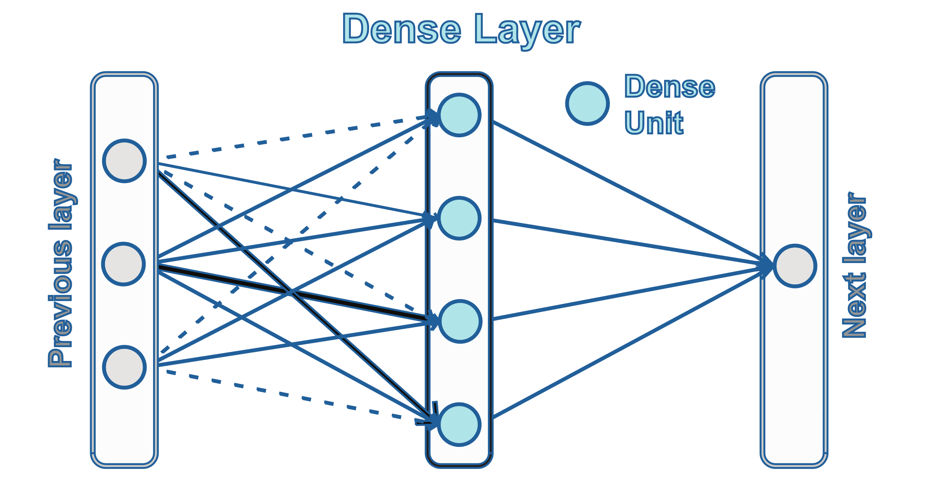
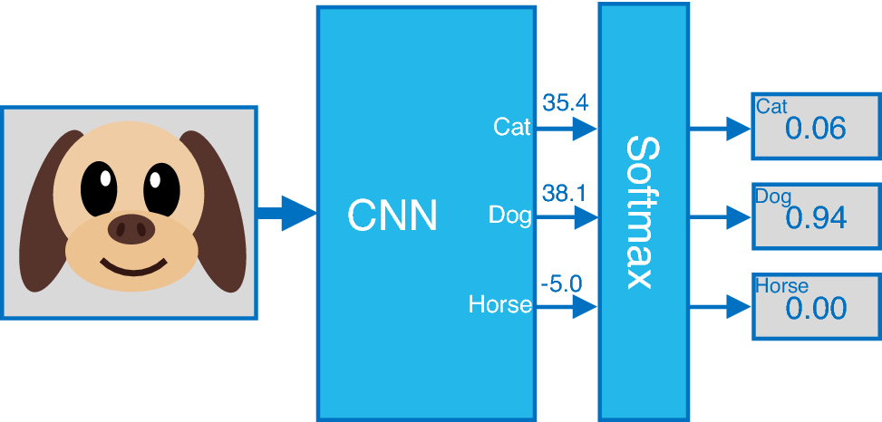
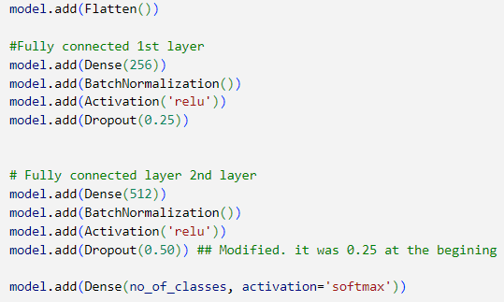
CNN Layers
Fully Connected Layers:
Following feature extraction by convolutional and pooling layers, the data is flattened and fed into fully connected (Dense) layers. A Dense layer, where each neuron is connected to every neuron in the previous layer, integrates features from earlier layers to classify input data into categories.
Softmax Activation Function:
The softmax used in the output layer of a neural network for multi-class classification problems.
It converts the raw output scores (logits) into probabilities, where each output value is in the range (0, 1) and the sum of all output values is 1.
This allows the network to assign a probability to each class.

Slide 11

Introduction to Keras
Keras is a powerful and user-friendly open-source neural network library, designed to enable fast experimentation with deep neural networks. It acts as an interface for the TensorFlow library, streamlining the process of designing and training deep learning models.
How Keras is used in our project
- Data Augmentation: Utilizing Keras's ImageDataGenerator, we automate the normalization of image data and augment your dataset in real-time.
- Model Construction: Keras's sequential API enables straightforward stacking of layers for building CNN models. This includes convolutional layers, ReLU activations, pooling layers, and dropout layers, all defined clearly using Keras's functional interfaces.
- Model Compilation: Keras's flexibility allows for specifying optimizer, loss function, and metrics crucial for effective learning from training data.
- Training: Keras facilitates model training with methods like .fit(), and we employ callbacks such as ModelCheckpoint, EarlyStopping, and ReduceLROnPlateau for efficient training, saving the best models, stopping training based on validation loss, and adjusting learning rate respectively.
- Evaluation and Prediction: Keras supports model evaluation on validation sets, providing straightforward metrics for accuracy and loss measurement. It also enables predictions, crucial for assessing the CNN's effectiveness in recognizing emotions from facial expressions.

Slide 12
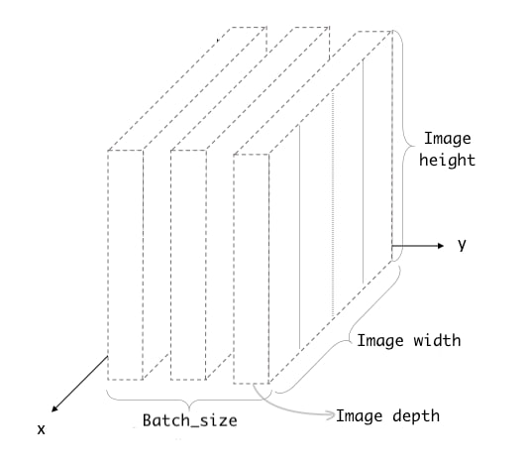

Training Process
Batch size:
Is the number of samples that will be passed through to the network at one time, i.e. instead of feeding the entire dataset to the neural network at once, we divide the dataset into smaller batches. The model is trained on these smaller batches one at a time. Have a look at your notebook
Learning Rate:
It is a crucial hyperparameter in neural network training, determining the step size at each iteration while moving towards a minimum of the loss function. It is typically set between 0.01 and 0.0001, representing small values to ensure gradual updates to the weights. Balances training speed and stability, impacting model accuracy and loss.
Notes:
So if choosing the Learning Rate too High (e.g., close to 0.01): Faster but risk of overshooting.
too Low (e.g., close to 0.0001): Slower but more stable convergence., resulting in longer training times.

Slide 13
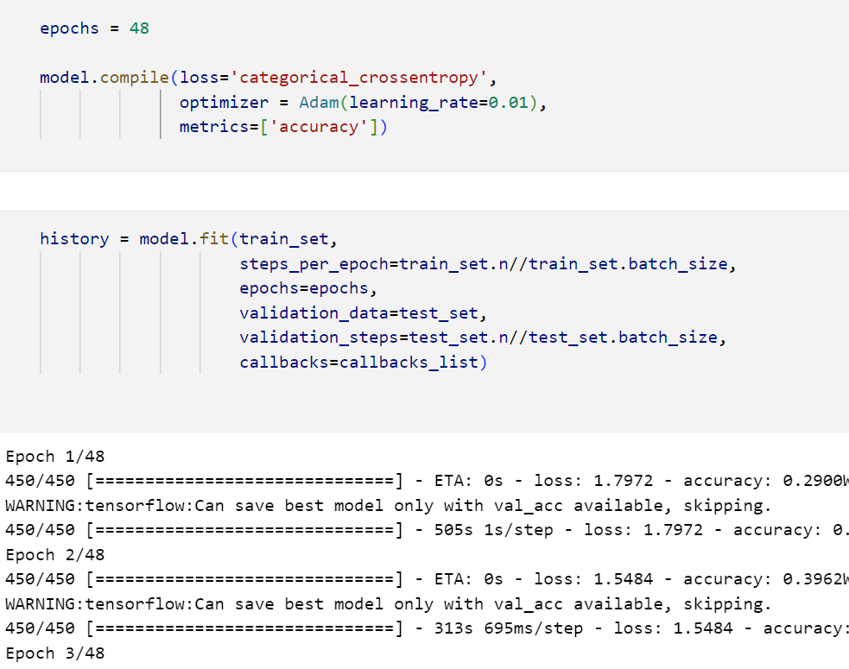
Training Process
Training Execution:
The training is executed via Keras's model.fit() function, specifying the number of epochs, batch size, and including the callbacks. This method efficiently manages the training loop, including forward and backward passes, weight updates, and logging of training/validation metrics.
Epochs:
An epoch is one complete pass through the entire training dataset. i.e. During training, multiple epochs are used to repeatedly pass through the dataset, allowing the model to learn and improve. Each epoch consists of multiple iterations (one iteration per batch).
Iteration:
is a single update of the model's weights. One iteration is completed each time a batch of data is processed, i.e. The number of iterations per epoch is determined by the batch size and the total number of training samples.
For example, with 18663 images and a batch size of 128, there will be 146 iterations in one epoch.
Notes:
After building our model and defining all the hyperparameters, we need to start training the model. To do that, we use model fit which is a function that helps us to run the model, by easily defining the number of epochs and the batch size, and also it provides the callbacks during the training. Here, we have two important terms. The first on is Epochs. During the one epoch, the model sees and pass all the data. The number of the epochs should be optimized because if there are too many epochs, the model works well on training data, but not on unseen new data. Each epochs includes multiple iterations. The second important term is Iterations. As my teammate said, we have divided our data to many batches of data. During each iteration, the model sees one batch of data. In each iteration, the waits will be updated.
The number of itrations, depends on the batch size.
We divide the whole number of images, by batch size to obtain the number of iteration.
An epoch in machine learning represents a single, complete pass through the entire training dataset.
Essentially, during one epoch, the model sees every example in the dataset once. This allows the model to learn from the data, adjusting its internal parameters (like weights) to improve. Training a model usually involves multiple epochs to ensure the model learns effectively from all the data. However, running too many epochs can cause the model to focus too much on the training data and perform poorly on new, unseen data. Therefore, finding the right number of epochs is crucial for building a well-generalized model."

Slide 14
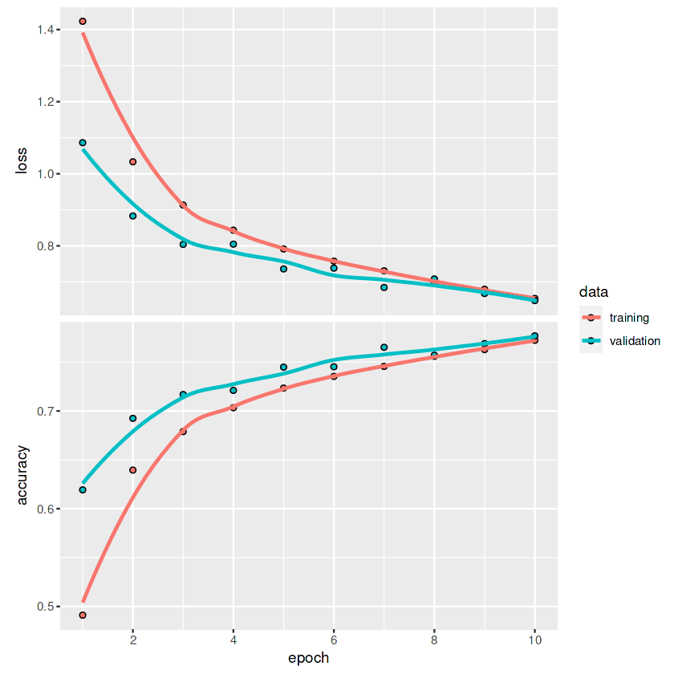
Training Process
Accuracy and Loss
Accuracy: Measures the percentage of correctly predicted emotion labels by the model against the actual labels. It's critical for assessing how well the model performs in recognizing and classifying different facial emotions accurately.
Loss (Cost Function): Our model calculates the error between its predictions and the actual labels. This is crucial for our classification task, where each prediction corresponds to a probability distributed across various emotional states. By measuring how far the predictions deviate from the true emotions, we ensure that the model adjusts and improves continuously, aiming to minimize these differences and enhance its predictive accuracy over time.
Notes:
Then dustiong the training process, we have also terms of accuracy and loss.
Accuracy calculates the percentage of correct predictons. It is calculated by dividing the number of correct predications by the total number of predictions. This parameter is used to evaluate the model performance.
Our aim is to reach the highest actuary possible, without facing overfitting
Then we have loss or cost function. That it calculate the error between the predicted lable and the true label.
the loss should be minimized by adjusting the weights

Slide 15

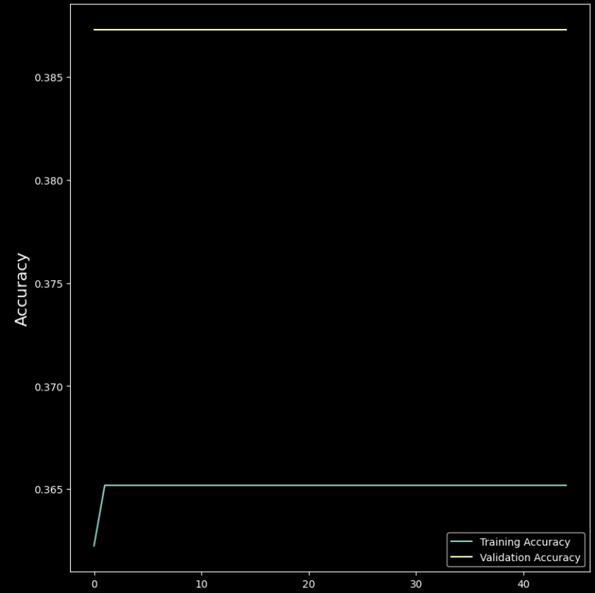
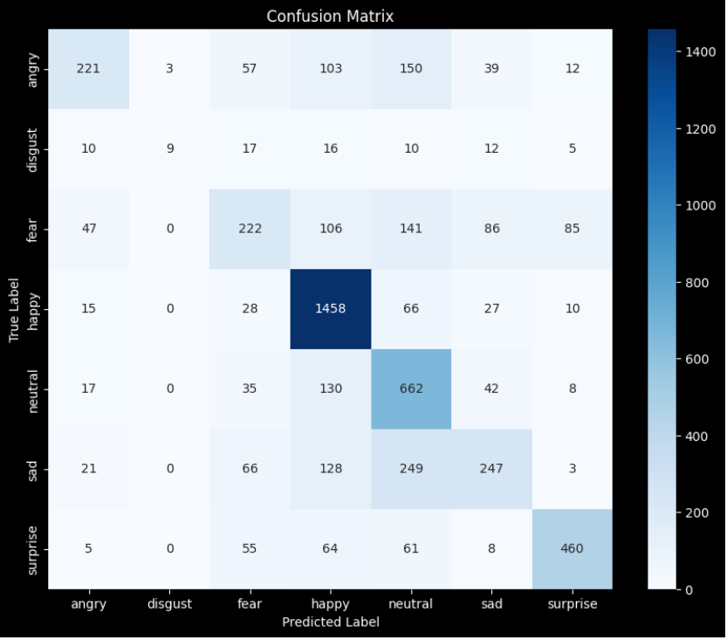
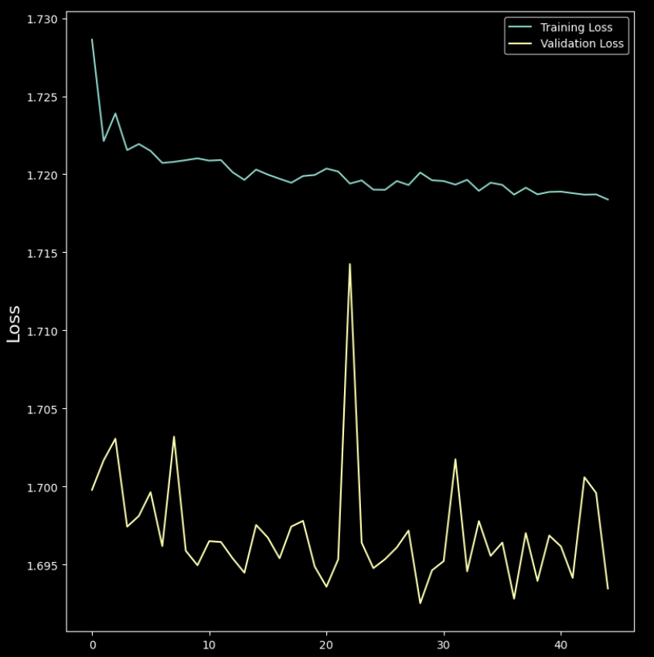
Model 1
Architecture
Evaluation
Results
Primary Problem:
- Low Accuracy
Initial results indicate a robust ability to recognize emotions, but there is room for improvement, particularly in generalizing beyond the training data to new, unseen images.
- Batch Size = 128
- Number of CNN Layers: 3
- Number of Dense Layers: 2
Activation: sigmoid
- Pooling Layer: MaxPooling2D
- optimizer: SGD
Padding
Training Accuracy: 36.52%
Training Loss: 1.7184
Validation Accuracy: 38.73%
Validation Loss: 1.6935

Slide 16
CNN Layers
Batch Normalization Layers:
Batch normalization layers are incorporated after each convolutional layer to normalize the activations and accelerate the network training. These layers provide considerable benefits by stabilizing the learning process, by ensuring that the activations across batches have a consistent mean and variance. Batch normalization helps in speeding up convergence and enhancing the overall training efficiency of the network.
Notes:
When normalization is done, the inputs are standardized or normalized.
When we apply batch normalization, to a layer, it normalizes the output of the activation layer. So we are normalizing the scales of the weights.
This technique also makes the training process faster.
When training a neural network we normalize or standardize data (we scale data) as a preprocessing step (preparing data for training), the purpose of normalization is to not have very high values data together with very low values like 10 and 10000, instead it’s for scaling it to 0 and 1, the large values can cause instabilities in our network leading to exploding gradient,

Slide 17
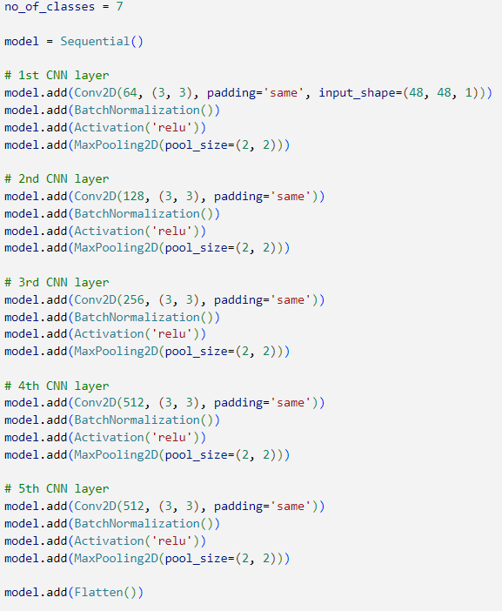
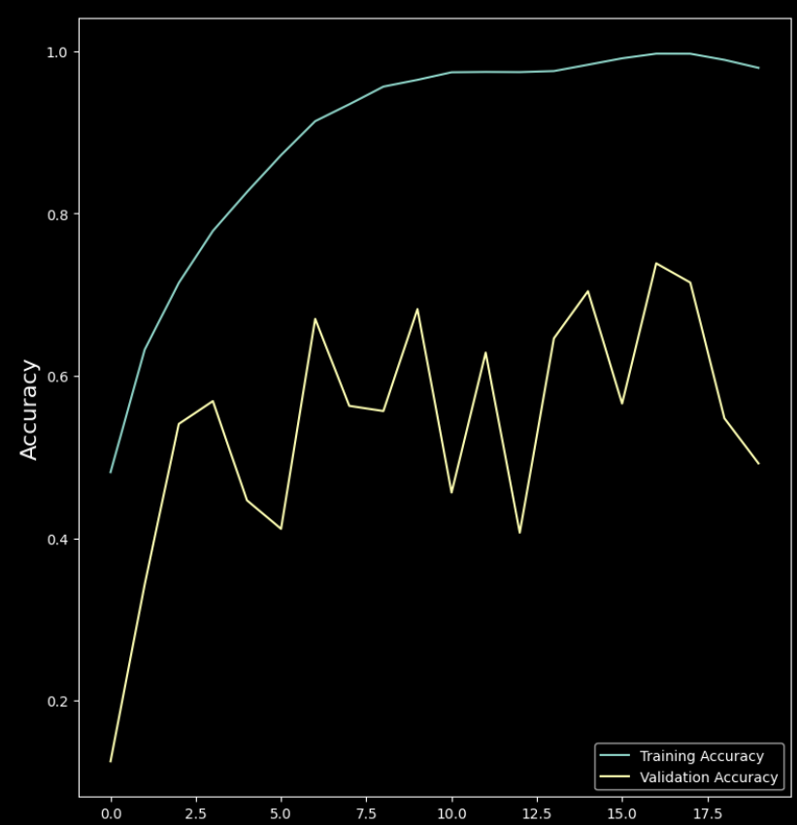
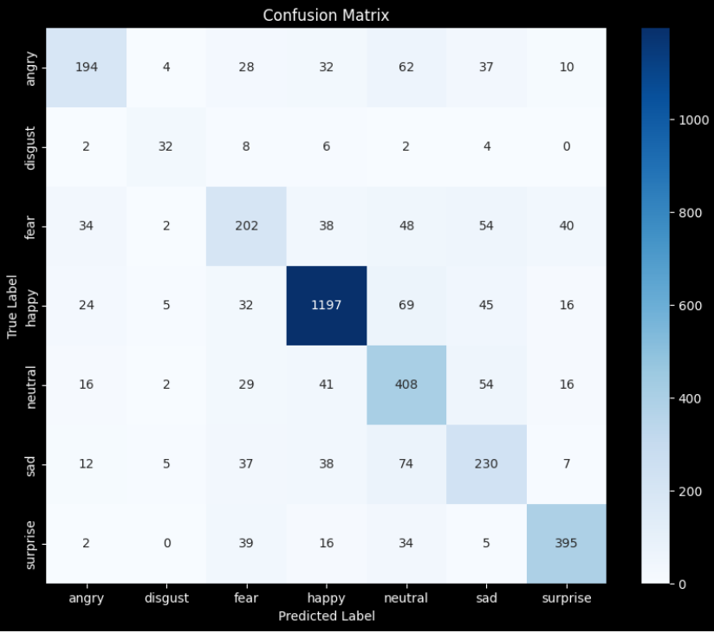
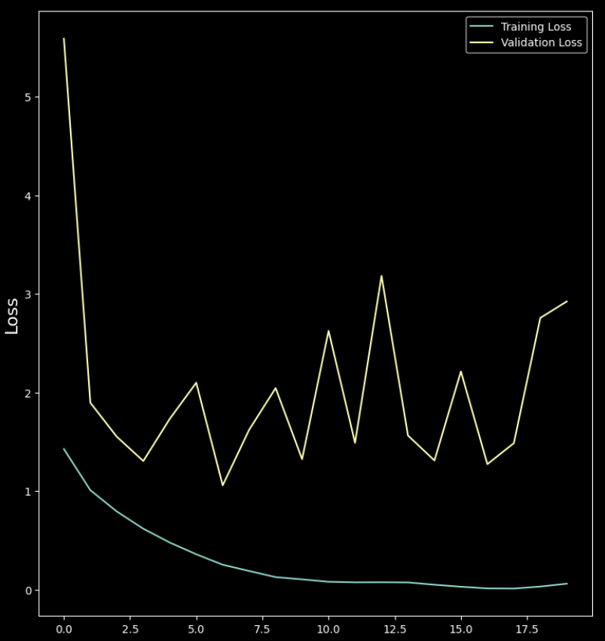
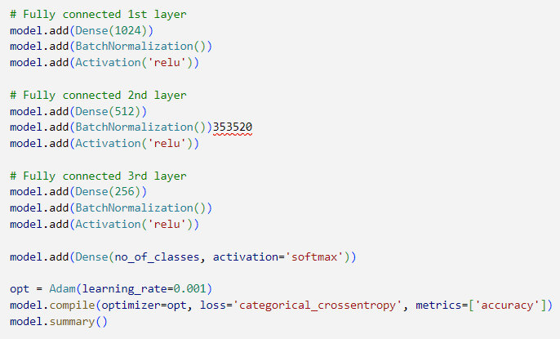
Model 2
Architecture
Evaluation
Results
Primary Problems:
- Overfitted
- High Noise and Outliers
Improvements:
- High Training Accuracy
Significant overfitting is evident with a training accuracy of 98% compared to a validation accuracy of 49%.
The model's excessive complexity leads to excellent performance on training data but poor generalization to new, unseen data.
- Batch Size = 256
- CNN Layers: 5 (Increased)
- Dense Layers: 3 (Increased)
- Activation: relu (Changed from sigmoid)
Increased the number of filters in Conv2D layers (up to 512 filters).
- optimizer: Adam (Changed from SGD)
- learning rate: 0.001 (Changed from 0.1)
Increased the number of neurons in dense layers.
- Pooling Layer: MaxPooling2D
BatchNormalization (Added)
Padding
Training Accuracy: 97.93%
Training Loss: 0.0604
Validation Accuracy: 49.22%
Validation Loss: 2.9230

Slide 18
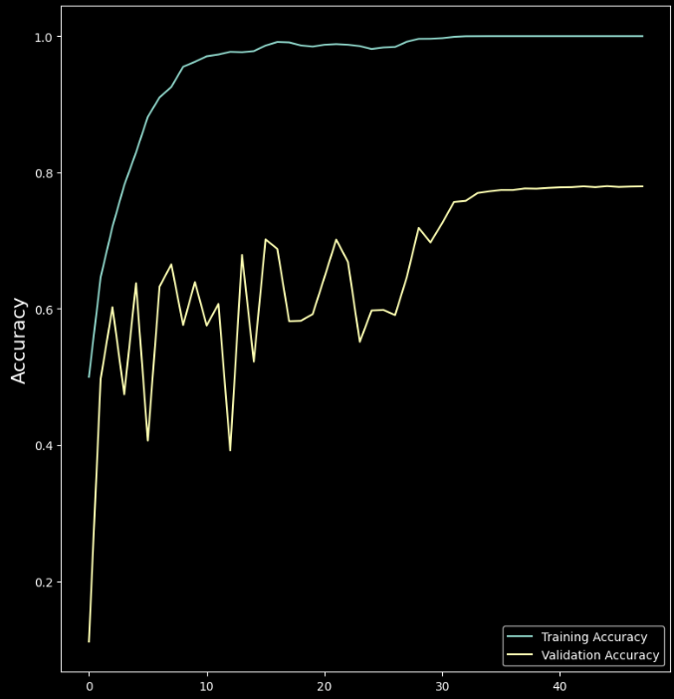
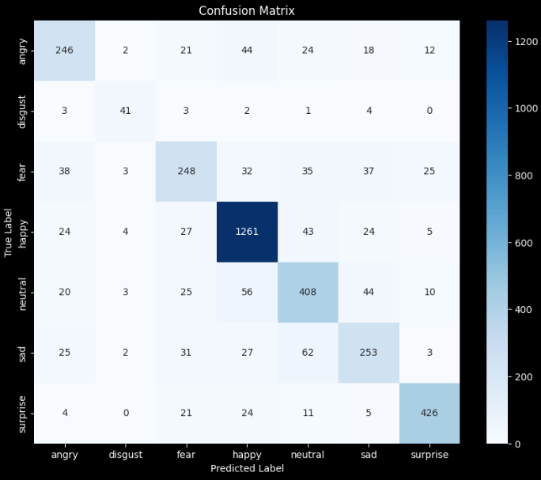
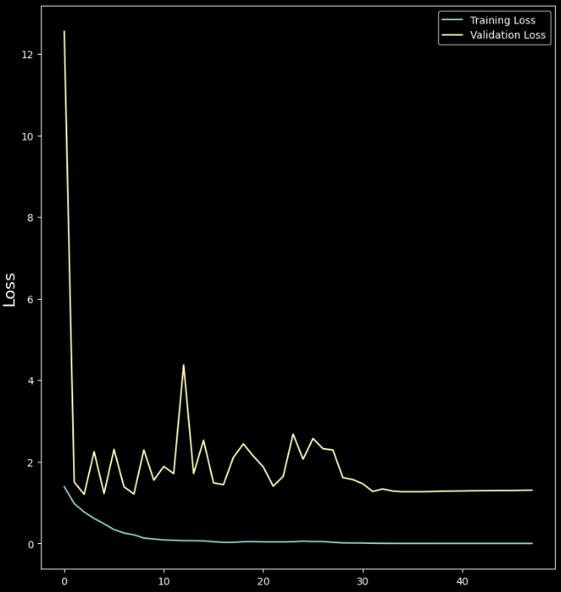
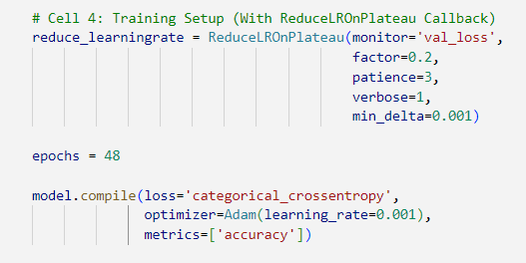
Model 2.1
Architecture
Evaluation
Results
Primary Problems:
- Still Overfitted Improvements:
- Minimized Noise and Outlier - Reduced Overfitting
Lowering the learning rate allowed the model to adapt more gradually, avoiding high overfitting, and smoother validation accuracy curve which shows the model’s decreased sensitivity to noise and outliers.
- Batch Size = 256
- CNN Layers: 5
- Dense Layers: 3
- Activation: relu
Number of filters in Conv2D: Unchanged
- optimizer: Adam
- learning rate: 0.001
- Number of neurons in Dense: Unchanged
- Pooling Layer: MaxPooling2D
- Added Learning Rate Reduction
BatchNormalization
Padding
Training Accuracy: 100.00%
Training Loss: 0.0001
Validation Accuracy: 77.96%
Validation Loss: 1.3050

Slide 19
CNN Layers
Dropout Layers:
Dropout layers are implemented in this CNN as a form of regularization to prevent overfitting, which is crucial for maintaining the generalization ability of the network when exposed to new, unseen data. By randomly ignoring selected neurons during training, dropout layers reduce the dependency on any single neuron, thus ensuring that the network's learning is robust and generalized.
Notes:
Dropout layer is an effective tool we use in our model to prevent overfitting, which happens when a model learns the features of the training data too well but it is not able to perform well on new data. So actually, the dropout is a method for making the model more robust for unseen data. The way it woks, is that during training, it randomly 'drops' or ignores a percentage of neurons. This helps the model to learn more general features. The result is a model that is less likely to rely on quirks in the training data and better at predicting new, unseen data

Slide 20
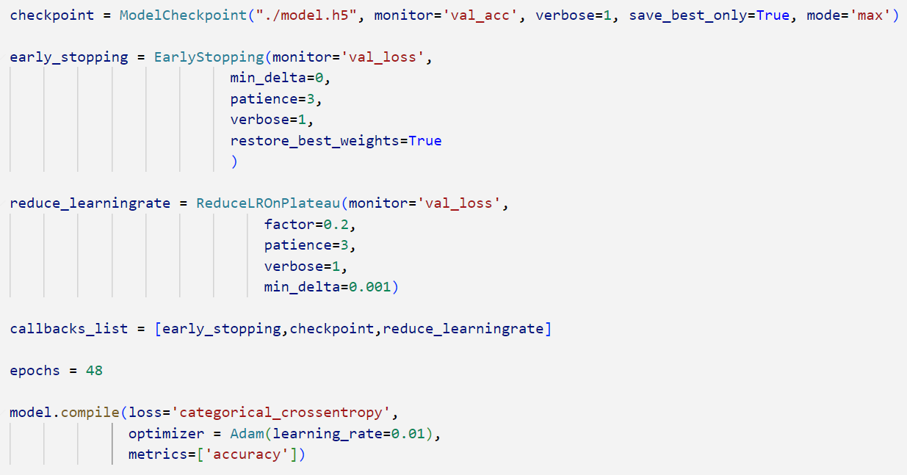
Training Process
Callbacks: Functions that are applied at certain stages of the training process to monitor and take actions on a model’s performance.
- ModelCheckpoint: Ensures the best model is saved by monitoring validation accuracy, allowing us to retain a snapshot of the model at its highest performance across the training epochs.
- EarlyStopping: Stops training when the validation loss fails to improve after a set number of epochs (patience set to 3), optimizing computational resources and preventing overfitting.
- ReduceLROnPlateau: Automatically reduces the learning rate when the validation loss stops improving, which helps refine model adjustments during later stages of training for better outcomes.

Slide 21
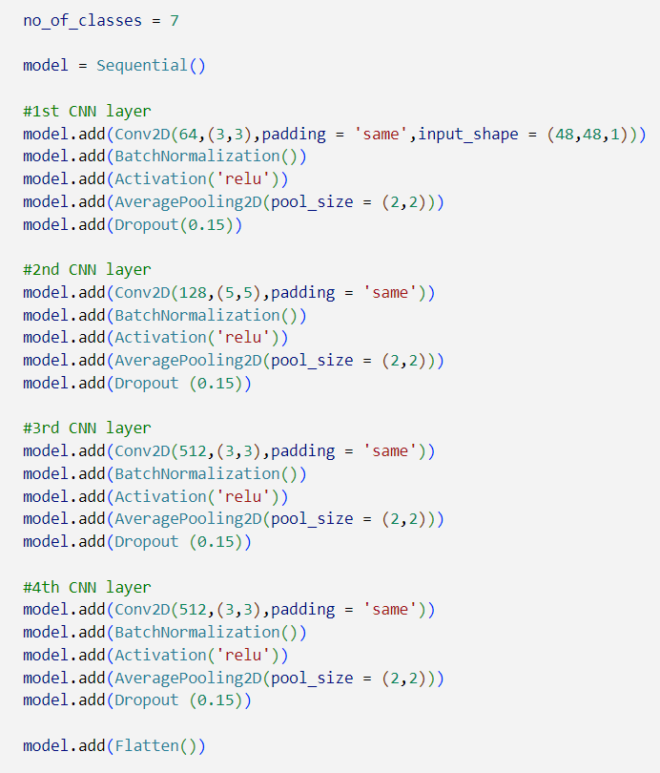
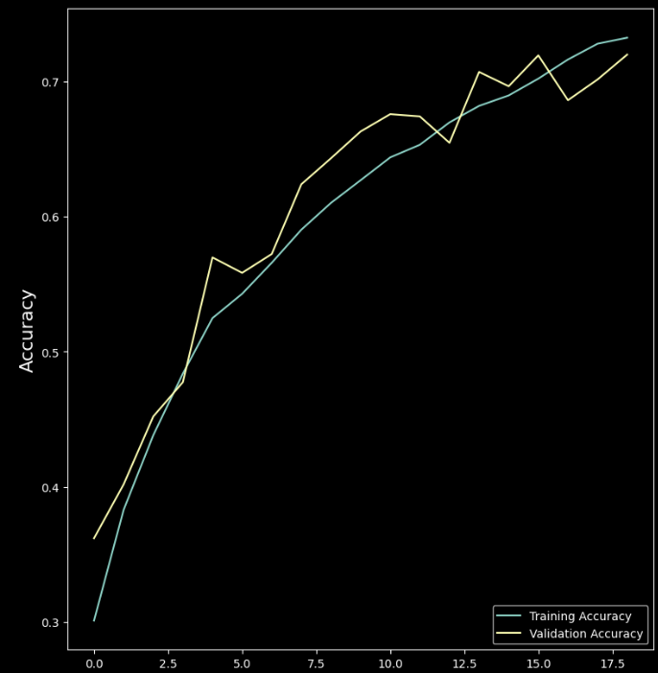

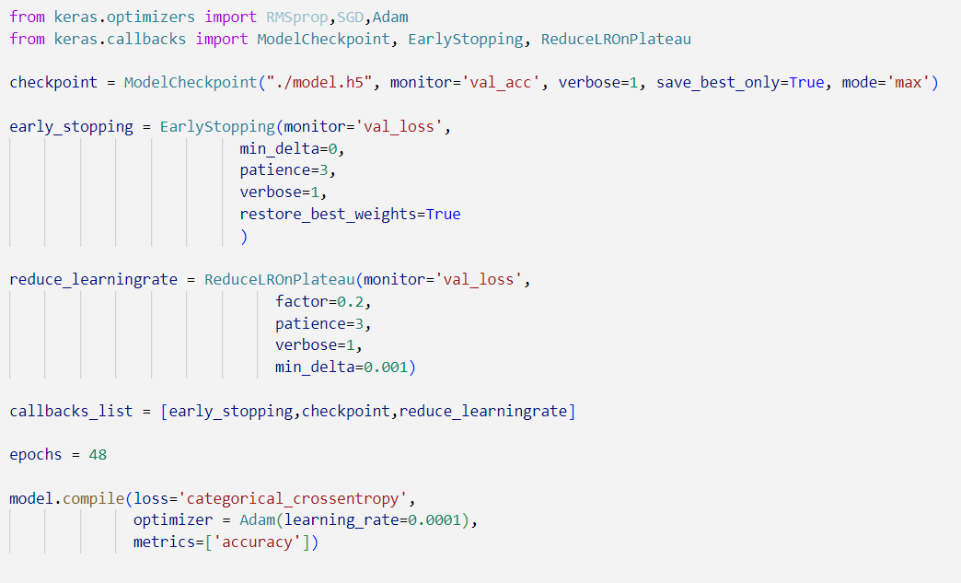
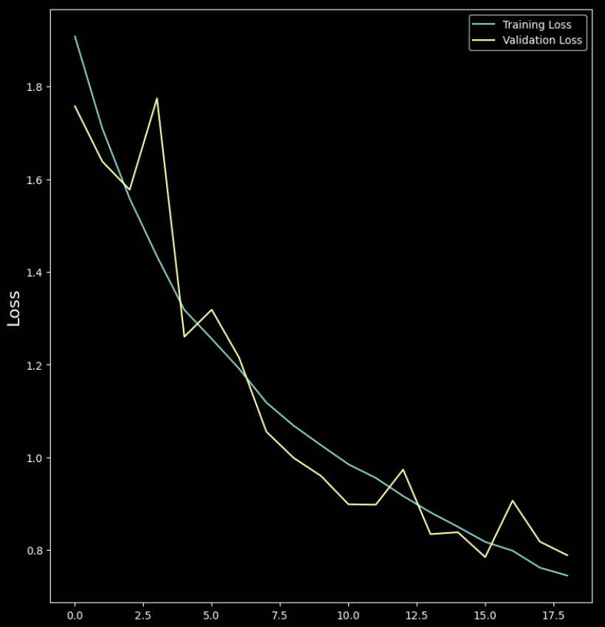
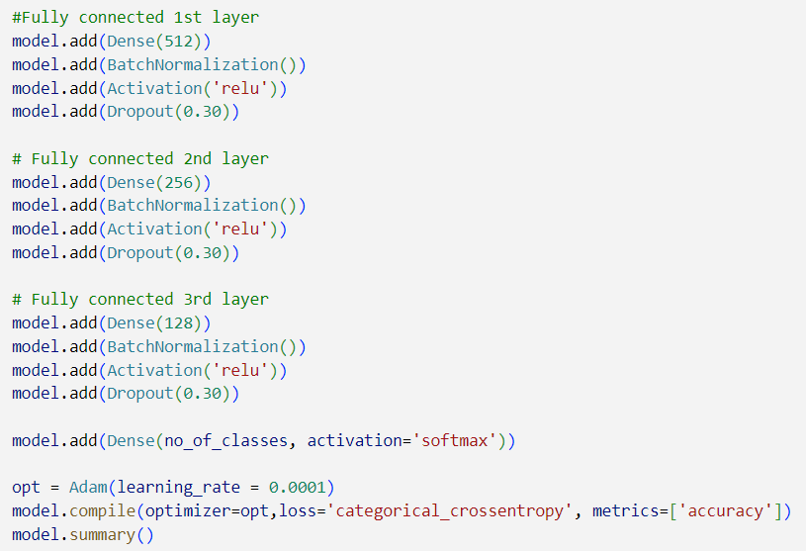
Model 3
Architecture
Evaluation
Results
- Batch Size = 128 (Reduced)
- CNN Layers: 4 (Reduced)
- Dense Layers: 3
- Activation: relu
- Number of filters in Conv2D: Changed
- Optimizer: Adam
- learning rate: 0.0001 (Changed)
- Number of neurons in Dense: : Changed
Pooling Layer: AveragePooling2D (Changed from MaxPooling2D)
Dropout layers (Added) - (0.15 for CNN layers, 0.30 for dense layers).
BatchNormalization
Padding
Learning Rate Reduction
EarlyStopping (Added)
ModelCheckpoint (Added)
Primary Problems:
- !!! ☺ Improvements:
- Overfitting Addressed
- Validation Accuracy Increased
Model 3 demonstrates significant improvements over Model 2 by effectively addressing overfitting and stabilizing validation accuracy. These enhancements contribute to better generalization and robustness, making Model 3 more reliable for practical applications.
Training Accuracy: 72.82%
Training Loss: 0.7481
Validation Accuracy: 70 %
Validation Loss: 0.8792

Slide 22
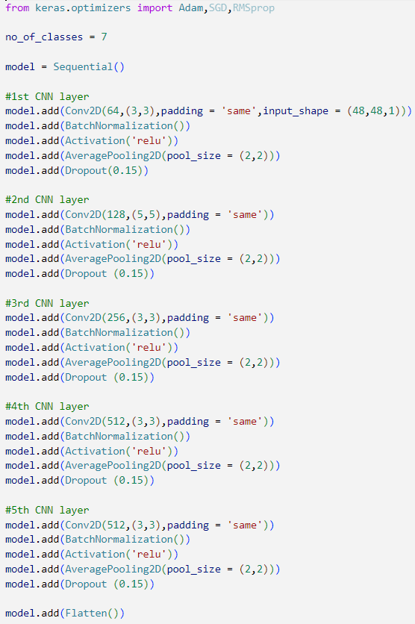
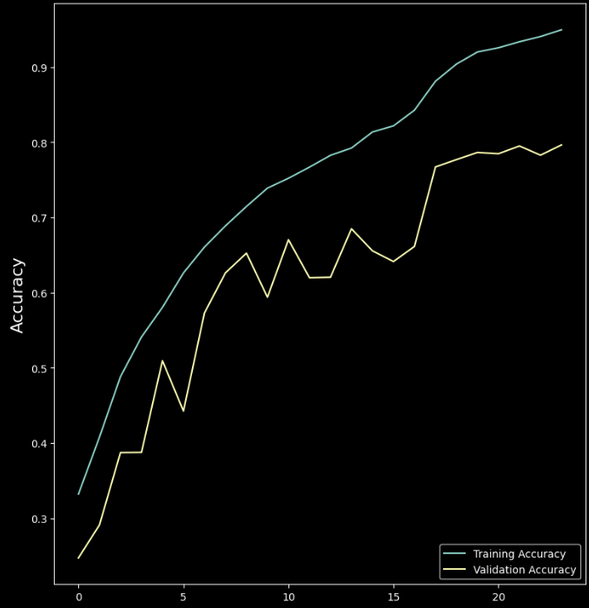
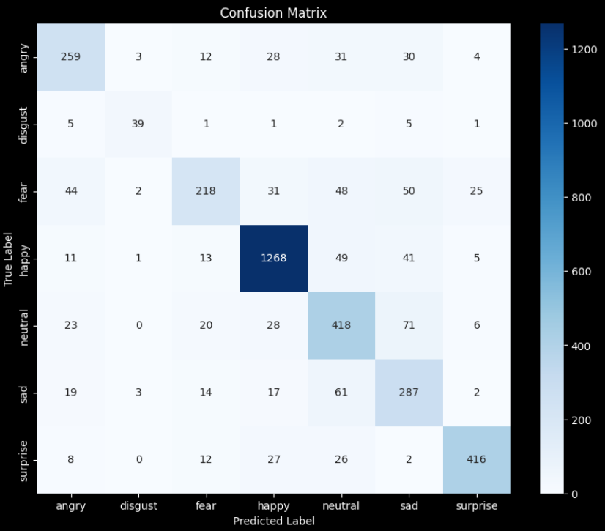
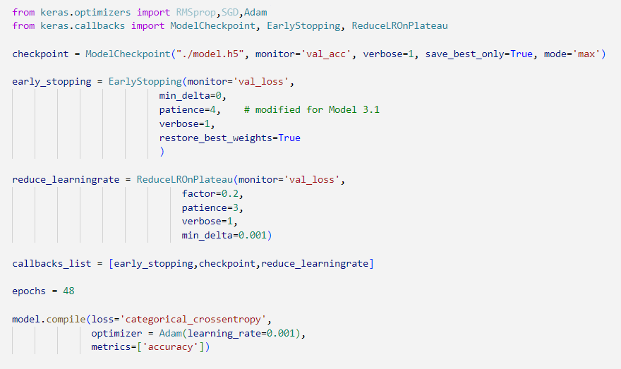
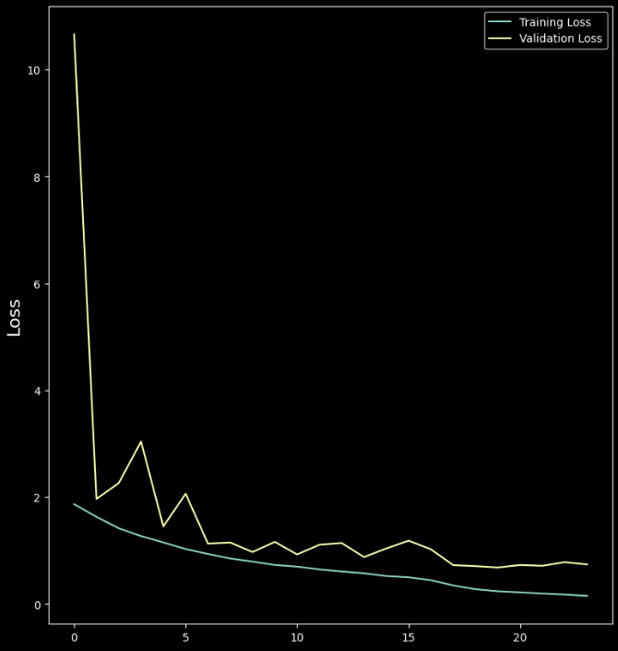
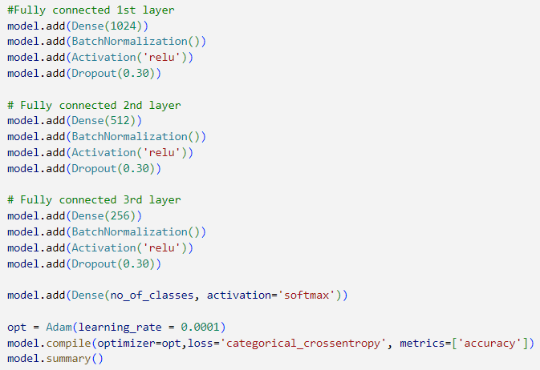
Model 3.1
Architecture
Evaluation
Results
- Batch Size = 256 (Increased)
- CNN Layers: 5 (Increased)
- Dense Layers: 3
- Activation: relu
- Number of filters in Conv2D: Changed
- Optimizer: Adam
- learning rate: 0.001 (Changed)
- Number of neurons in Dense: Changed
Pooling Layer: AveragePooling2D
Dropout layers
BatchNormalization
Padding
Learning Rate Reduction
EarlyStopping Patience: 4 (Changed)
ModelCheckpoint
Primary Problems:
- Overfitting Observed Improvements:
- Validation Accuracy Increased
Training Accuracy: 95 %
Training Loss: 0.1502
Validation Accuracy: 80 %
Validation Loss: 0.7389

Slide 23
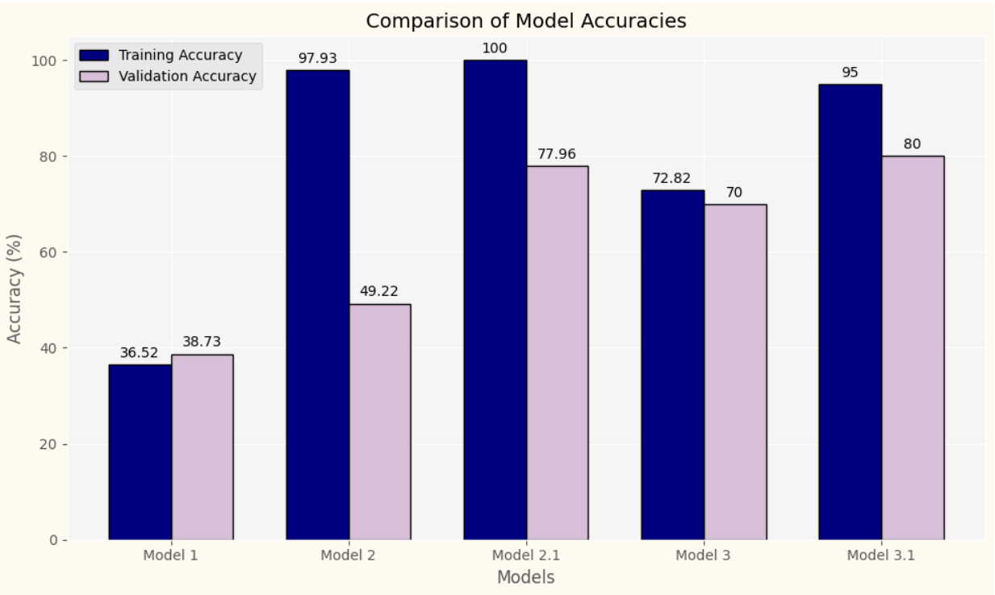
Final Results

Slide 24

For your Attention

Slide 25
For your Attention

Slide 26
For your Attention

Slide 27
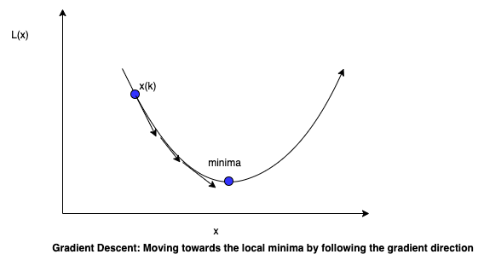

Training Process
Optimizers:
Optimizers are crucial for fine-tuning neural network weights and learning rates to minimize loss functions. They play a vital role in model training by determining how quickly and effectively a model can converge to its lowest error state.
Stochastic: Gradient Descent (SGD)SGD is a fundamental optimizer that uses a single data point at a time to update parameters, making it highly efficient for large datasets. It's simple and robust but may require more iterations to converge, often making it slower than more sophisticated techniques.
Adam (Adaptive Moment Estimation): Adam improves upon SGD by adjusting the learning rate for each parameter based on how frequently it is updated during training. This makes it faster and more effective for complex models and large datasets, as it automatically adapts to the nature of the problem.
Backpropagation: Backpropagation, short for "backward propagation of errors," is a fundamental algorithm used for training neural networks. It efficiently computes the gradient of the loss function with respect to the weights of the network, which is essential for optimization techniques like Stochastic Gradient Descent (SGD).

Slide 28












A Problem Statement and Smart Solution
Problem:
The dataset contained many images where the emotion of the face was not detectable even by a human.
This led to images in different folders not corresponding to the correct emotion label, and improper training of the model, leading to errors and confusion.
Traditional Solution:
Manually checking and deleting each incorrect image, one by one.
But it is Impossible due to the large dataset size of 27,000 images.
Smart Solution:
Developed an intelligent code that utilizes pre-trained models to automatically filter out incorrect images.

Slide 29

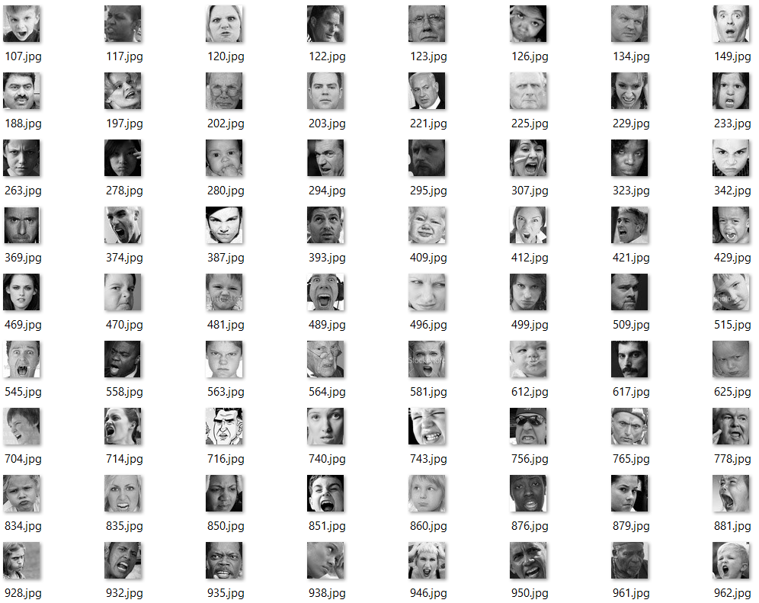
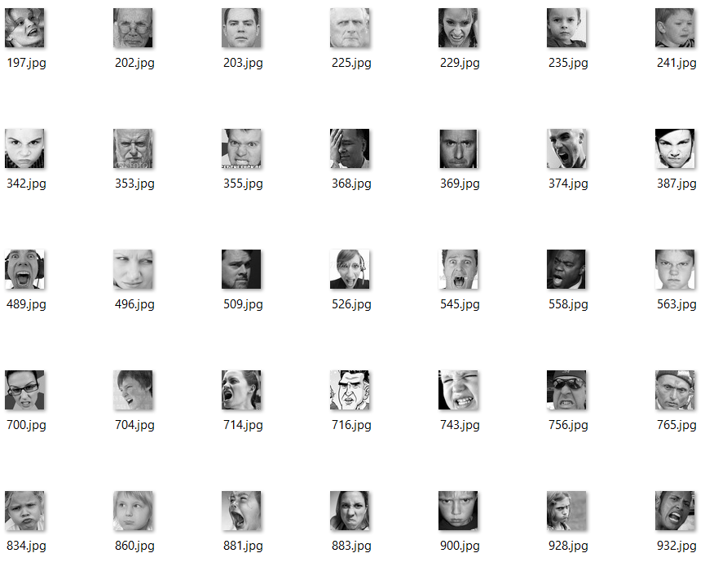
Smart Solution Implementation
Filtering by DeepFace Library
DeepFace is a powerful library for facial recognition and emotion detection.
It incorporates multiple pre-trained models like VGG-Face, Google FaceNet, OpenFace, Facebook DeepFace, and DeepID.
Output: A new filtered dataset, containing only images with clear and correct emotions
Input:
The existing old dataset

Slide 30
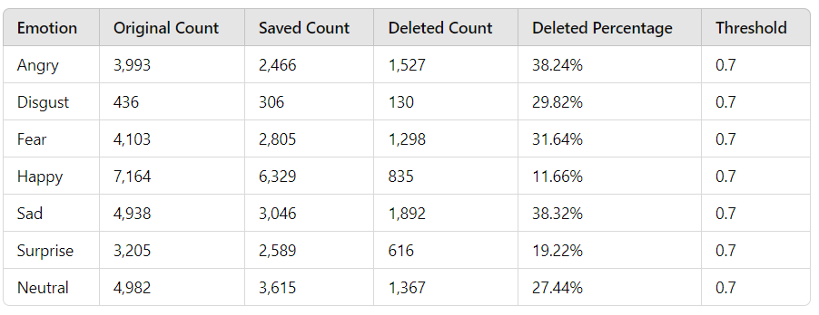
Smart Solution Implementation
Results:
This automated filtering significantly improves the dataset quality, leading to better model training and accuracy.
This smart solution effectively addresses the problem of mislabeled images in large datasets.
Filtering Results for Train Dataset:

Slide 31
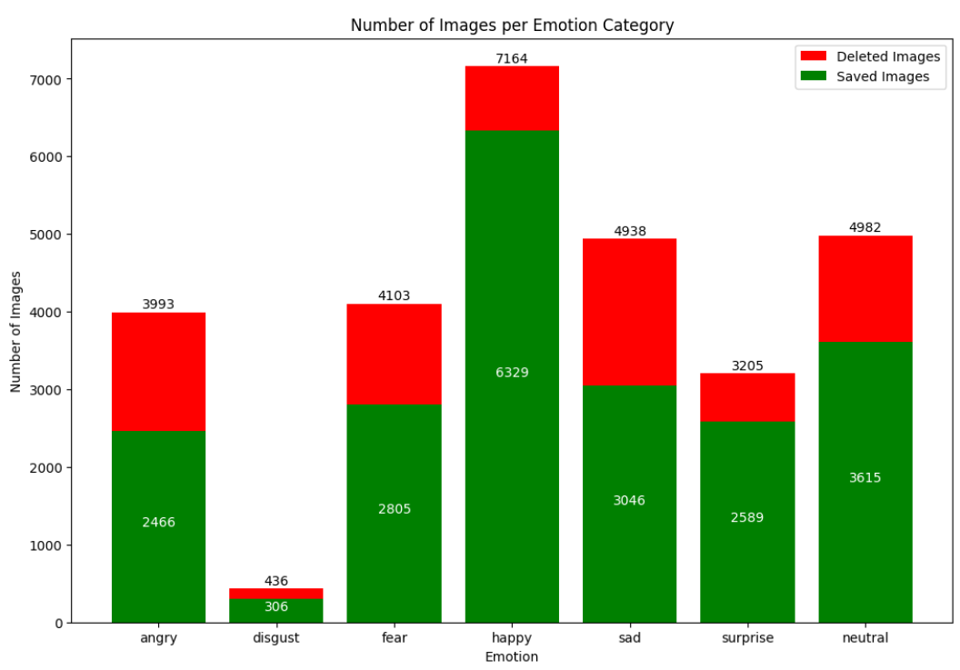
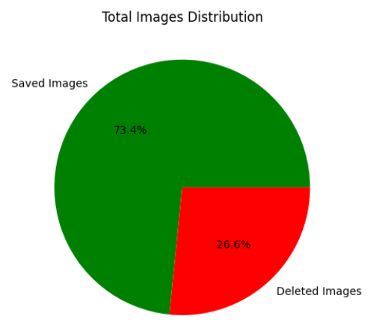
Smart Solution Implementation
Filtering Results for Train Dataset:

Slide 32
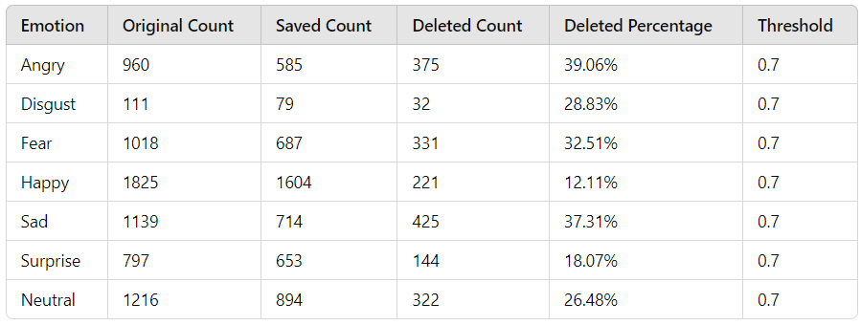
Smart Solution Implementation
Filtering Results for Validation Dataset:

Slide 33
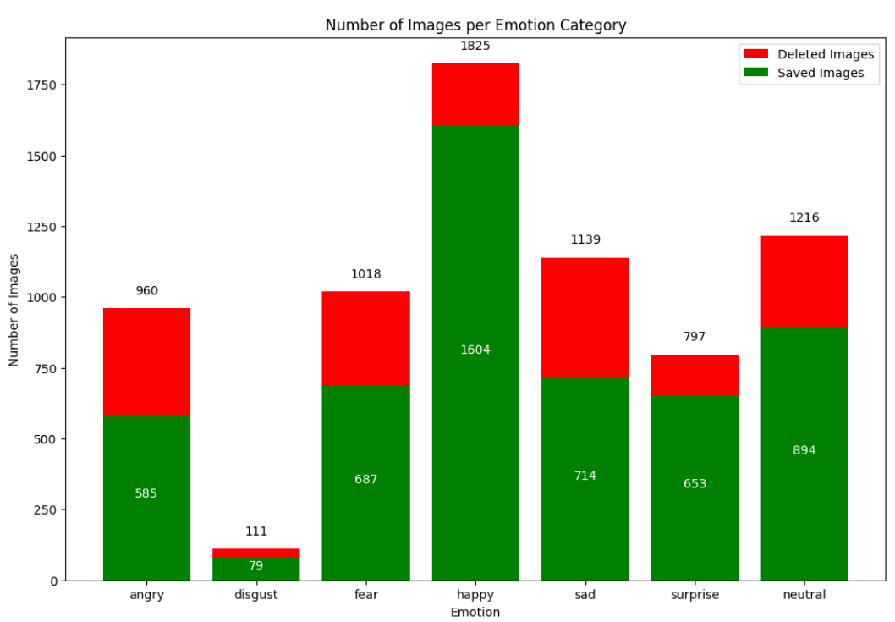

Smart Solution Implementation
Filtering Results for Validation Dataset:

Slide 34
Smart Solution Implementation
Threshold Parameter:
Purpose: To adjust the sensitivity of the code.
Functionality:
Defines the minimum confidence level required for an image to be considered correctly labeled.
Higher threshold values result in stricter filtering, ensuring only images with very clear emotions are kept.
Lower threshold values allow more images to pass the filter, even if the emotion detection confidence is lower.

